Slide 1
IGNORANCE-BASE
DATA REPRESENTATION

Slide 2
Ignorance theory helps identify the types of knowledge goals in a field
Known Unknowns/ Ignorance
Questions Answered by this work
LEVELS OF EVIDENCE
Full Unknown
Incomplete Evidence
Anomaly/Curious Finding
Explicit Question
Superficial Relationship
Probable Understanding
BARRIERS
FUTURE OPPORTUNITIES
Alternative Options/Controversy
Difficult Task
Problem/Complication
Future Work
Future Prediction
Important Consideration
Knowledge Goals | Find the answer in the article to confirm fully answered | Find more evidence based on confidence (in increasing order) | Explore the result and determine if repeatable | Explore new avenues to overcome the barrier | Consider the future information
Research
Knowns/Answers/Facts/Not Ignorance
Notes:
With our goal to automate the process of finding known unknowns or ignorance in the literature, we discovered different types of them via their goals for scientific knowledge. Now we are more specific about the types of unknowns we have. For example…
We have 3 broad categories as shown in all caps and13 narrow ones as shown.
The arrow under levels of evidence, note that it is showing the progression of evidence in getting to knowledge.
We are focusing on the knowledge goals to organize them and so here are some knowledge goals for the broad categories and these are what really help define the research moving forward in terms of the knowledge goal we have to do the research on. Hopefully the research will lead to some knowns/answers/facts/not ignorances and it most likely will also lead to more known unknowns or ignorance, thus the cycle back.
Thus, these ignorance categories or knowledge goal categories can help identify the types of knowledge goals in the field and help a grad student, researcher, funder, or conference organizer understand what types of questions or knowledge goals exist in the field and how they are communicated.

Slide 3

The Ignorance-Base contains a lot of data
Ontology mapping:
720,313 OBO concepts
95.3% mapped
Literature: PMCOA
(1,643 prenatal nutrition articles = 91 gold standard, 1,552 automatic)
Biomedical Concepts
Ignorance-Base
(knowledge-goal-base)
+
=
Biomedical Concept Recognition
Ignorance Classifiers
Ignorance Theory
Nodes | 857,766 | 780,753 | 1,638,519
Edges | 1,815,645 | 5,072,064 | 6,887,709
PheKnowLator: Dr. Tiffany Callahan
Notes:
850 nonexistent IDs made by Negacy’s stuff
1,432 unique errors
Make sure to say caveats of all the work because automatic. This is the ignorance-base we are going to be exploring

Slide 4




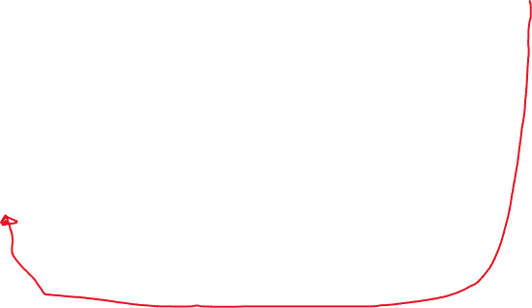
Ignorance-Base
Biomedical Concept Recognition
Literature: PubMed
NCBI Organismal Classification Ontology
Molecular Process Ontology
Find Sentences, Articles, Ignorance and not
Chemical Entities of Biological Interest Ontology
Ignorance Classifiers
Sequence Ontology
Vitamin D (ChEBI:27300)
Protein Ontology
Gene Ontology
Cell Ontology
Uber-Anatomy Ontology
PheKnowLator: Dr. Tiffany Callahan
Exploration by Topic
Ignorance Theory
Notes:
Here is a reminder of adding the ignorance – we can now split the sentences

Slide 5
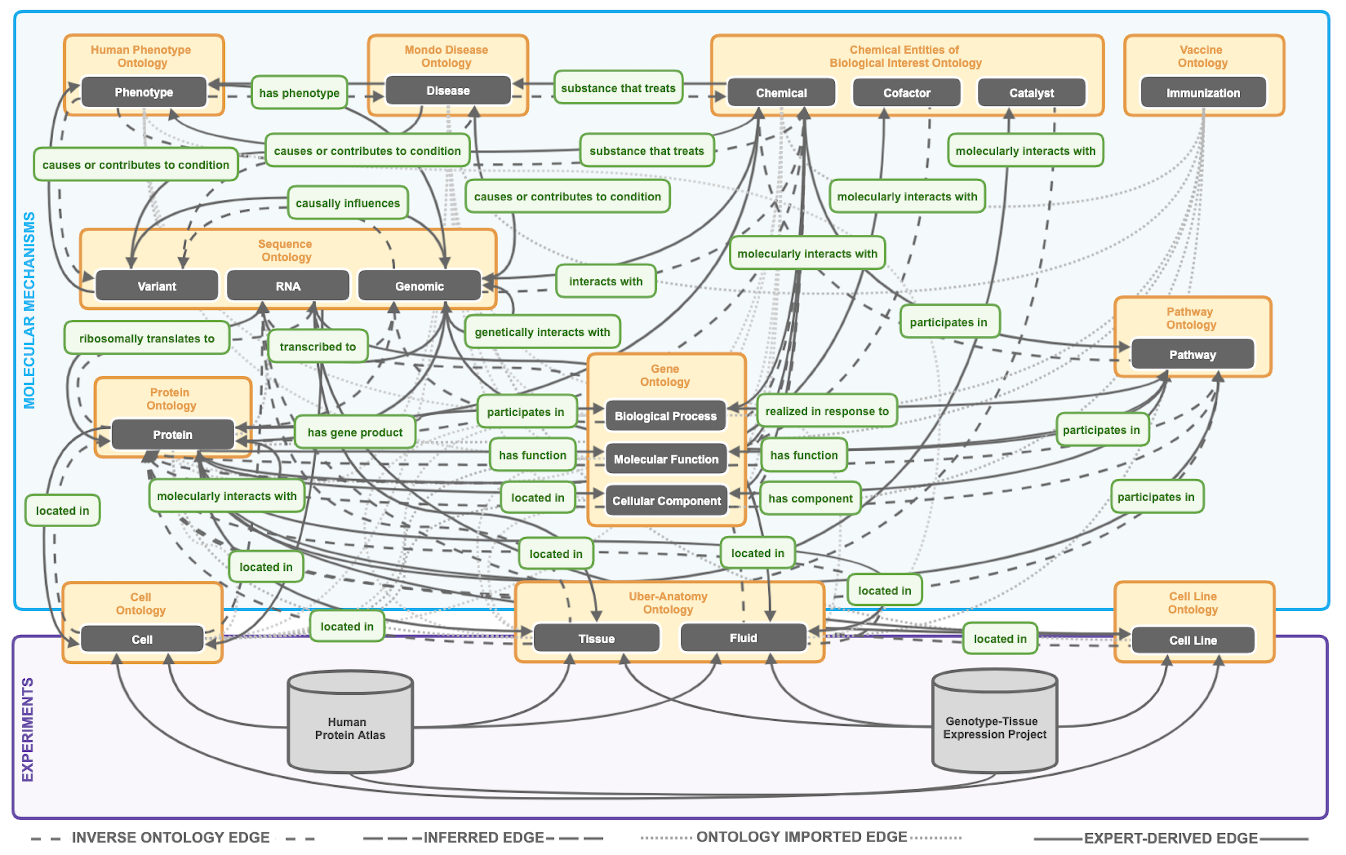





Ignorance-Base
Biomedical Concept Recognition
Literature: PubMed
NCBI Organismal Classification Ontology
Molecular Process Ontology
Chemical Entities of Biological Interest Ontology
Ignorance Classifiers
Sequence Ontology
Genomic
Protein Ontology
Gene Ontology
Cell Ontology
Uber-Anatomy Ontology
Gene List
PheKnowLator: Dr. Tiffany Callahan
Exploration by Gene List (Entrez Genes)
Ignorance Theory
Notes:
The real power of PheKnowLator are the semantically correct connections that Tiffany makes between the ontologies and other knowledge, such as genes. We can now use these connections to go from experimental results such as a gene list the other ontologies through the carefully curated relations ontology.
-- maybe just put a gene list where experiments are and add entrez genes.
Highlight the Genes to Proteins connection

